Slide 1
Camping Promotion
2023

Slide 2
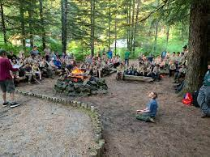
Why Go Camping?
-Camping is a fun part of Scouting and the OA
-Enjoy the outdoors with others
-Experiences that only scouting has to offer
- High Adventure Bases
- OA Camping Events
-Rank advancement and requirements
-Become camp staff

Slide 3
Where Are Some Places to Camp?

Slide 4
High Adventure Bases
-Florida Sea Base
-Philmont Scout Ranch
-Northern Tier
-The Summit
-Exciting and unique adventures are offered at High Adventure Bases
-Camperships available to help with cost

Slide 5
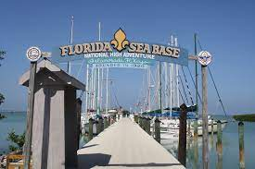
Florida Sea Base
-Located in Florida
-Offers ocean based activities
-Help plant and care for a coral reef
-Introduction to SCUBA
-Watercrafts such as canoes, kayaks, and paddleboards

Slide 6
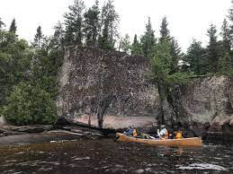
Northern Tier
-Located in the Boundary Waters of Minnesota
-Experience a canoeing trek through the border of Canada and the U.S.
-Northern wildlife such as moose
-Exclusively canoe-access wilderness
-Canoe through clear lakes and tall forests

Slide 7
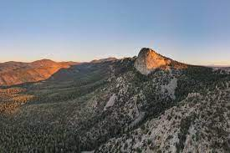
Philmont Scout Ranch
-Located in Cimarron New Mexico
-Over 214 miles of wilderness
-Historical landmarks including 19th century buildings, a crashed B-24 bomber, a Tyrannosaurus Footprint, and The Tooth of Time
-Centered on backpacking through the New Mexican outback

Slide 8
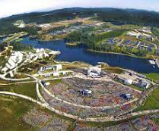
The Summit
-Located in Virginia
-1 Week experience
-Variety of activities
-¾ mile course of zip lining

Slide 9
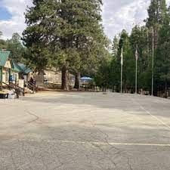
Summer Camps
-Forest Lawn Scout Reservation (“Circle X”)
-Emerald Bay
-Camp Tahquitz
-Fiesta Island
-Lost Valley
-Camp Emerson

Slide 10
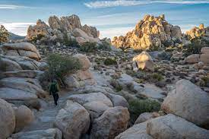
Joshua Tree National Park
-Vast desert with many rocks and boulders
-Home to the Joshua Tree
-Located in the Mojave Desert
-Plentiful with desert wildlife
-Many hiking and backpacking opportunities

Slide 11
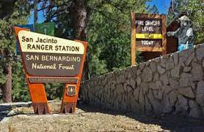
Joshua Tree National Park
-Nearby Riverside
-Large forest area
-Tall pines with many forest wildlife
-Includes Big Bear
-823,816 Acres of land

Slide 12
Camp Emerson
-California Inland Empire Camp
-Contains Camp Brown
-Many activities such as blacksmithing, water sports, and hiking
-Oldest scouting camp West of the Mississippi River
-Many events held at Emerson

Slide 13
OA Camping Opportunities
-OA Camperships
-Conclave
-Fall Fellowship
-Meet new Arrowmen
-Learn about the OA
-Provide community service
-Work towards Brotherhood

Slide 14
You Can’t Spell
Without
SC
OUTING
Notes:
Play presentation and click to activate animation

Slide 15
Resources
-California Inland Empire Council Website
-Camp Emerson Page
-OA Website
-Cahuilla Lodge Website
-Section G18S Website

Slide 16
Questions?

